Slide 1

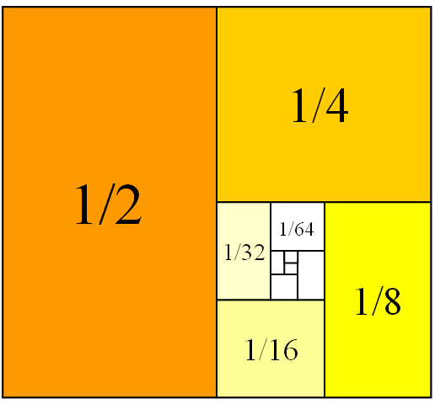
Mathematics for Engineering: Calculus
Chapter 1: INTEGRATION
(Tích phân xác định)
Department of Mathematics, FPT University

Slide 2
Contents
1.1 Approximating Areas
1.2 The Define Integral
1.3 The Fundamental Theorem of Calculus
1.4 Integration Formulas and
the Net Change Theorem
1.5 Substitution

Slide 3
INTEGRATION
1.1
Approximating Areas
In this section, we will learn that:
We get the same special type of limit in trying to find
the area under a curve.
Notes:
Area under a curve as the limit of a sum areas of thin rectangles.
Distance in terms of the velocity curve.
Notation of Riemann Sum.
Approximation of areas using rectangles (the right hand, left hand and midpoint sums).

Slide 4
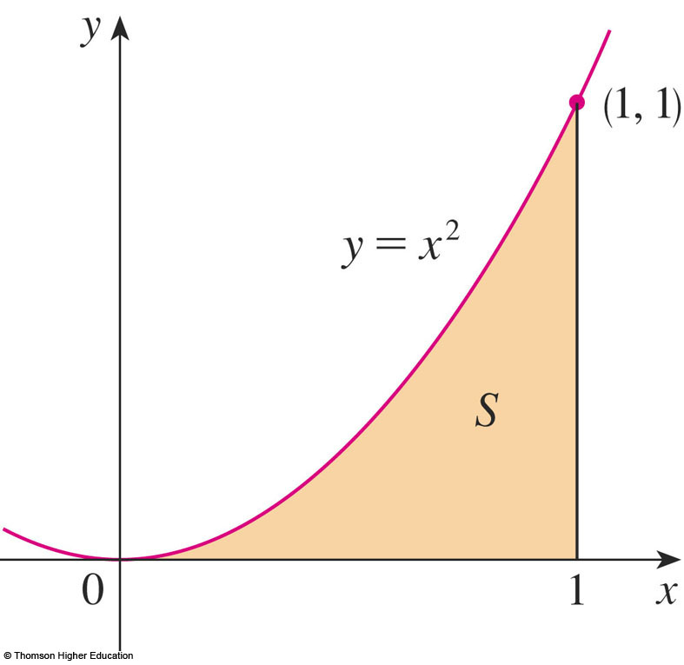
AREA PROBLEM
We begin by attempting to solve the area problem:
Find the area of the region S that lies under the curve y = f(x) from a to b.

Slide 5
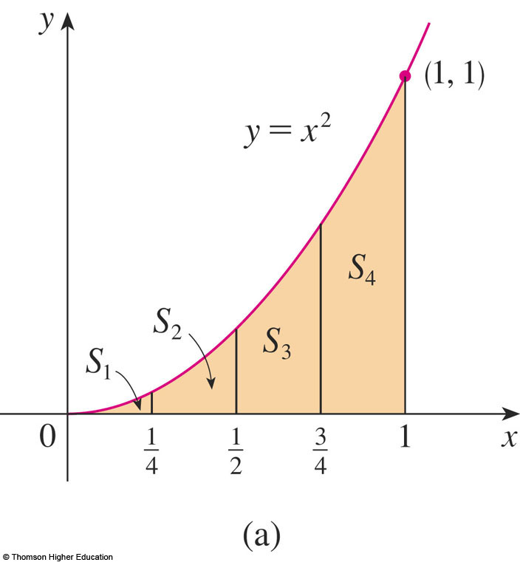
AREA PROBLEM
Example 1
Suppose we divide S into four strips S₁, S₂, S₃, and S₄ by drawing the vertical lines x = ¼, x = ½, and
x = ¾.

Slide 6
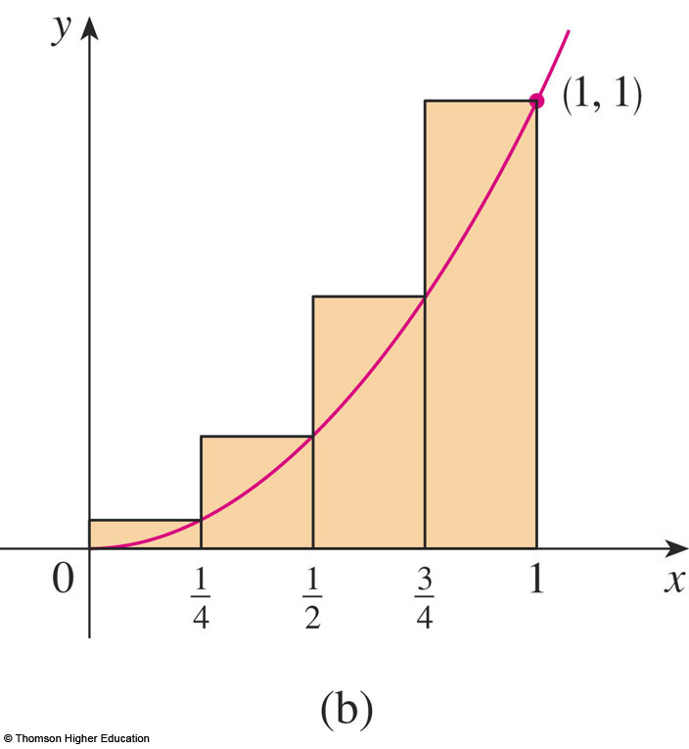
AREA PROBLEM
Example 1
The heights of these rectangles are the values of the function f(x) = x² at the right endpoints of the subintervals
[0, ¼],[¼, ½], [½, ¾],
and [¾, 1].

Slide 7
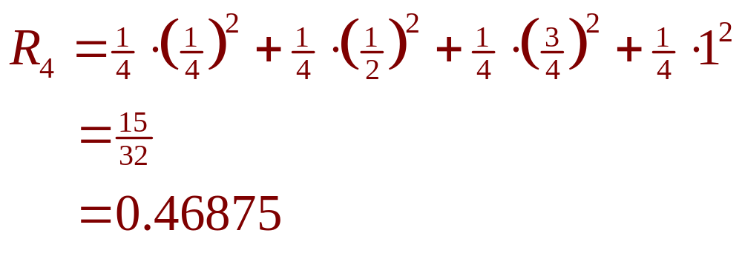
AREA PROBLEM
Example 1
Each rectangle has width ¼ and the heights are (¼)², (½)², (¾)², and 1².

Slide 8
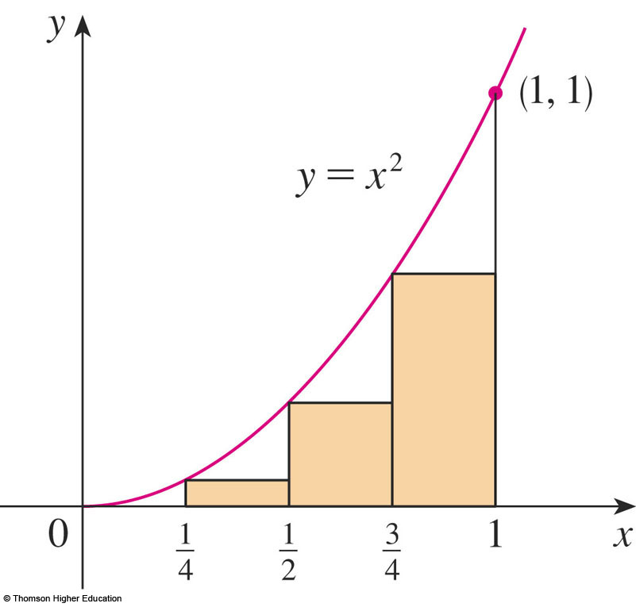
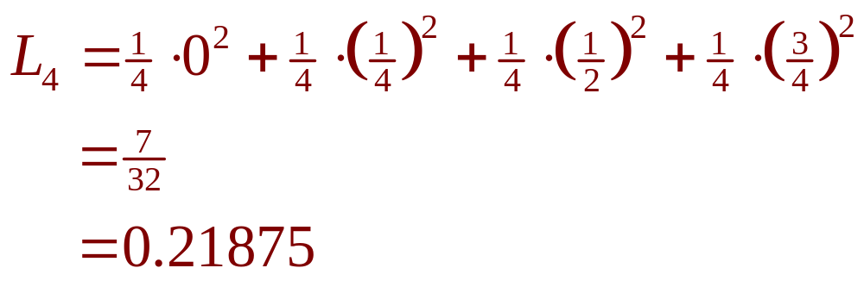
AREA PROBLEM
Example 1
Here, the heights are the values of f at the left endpoints of the subintervals.

Slide 9
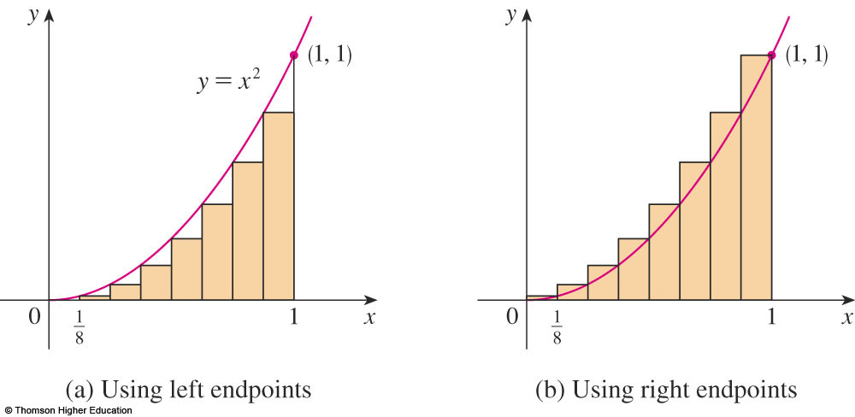
AREA PROBLEM
Example 1
The figure shows what happens when we divide the region S into eight strips of equal width.
0.2734375 < A < 0.3984375

Slide 10
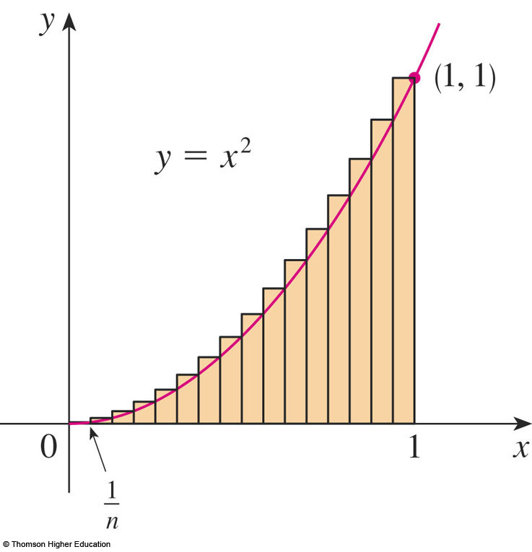
AREA PROBLEM
Example 2
R_{n} is the sum of the areas of the n rectangles.
  Each rectangle has width
  1/n and the heights are
  the values of the function
  f(x) = x² at the points
  1/n, 2/n, 3/n, …, n/n.
  That is, the heights are
  (1/n)², (2/n)², (3/n)², …,
  (n/n)².

Slide 11
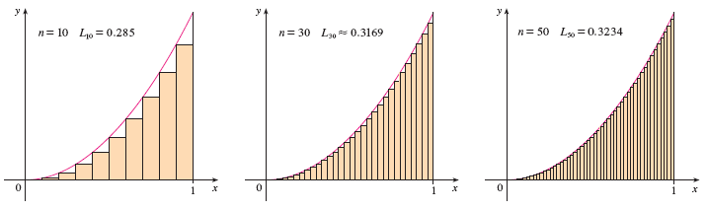
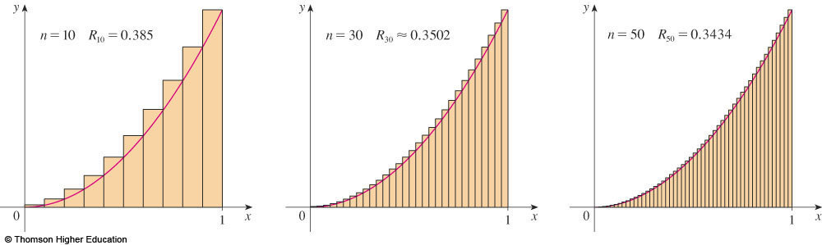
AREA PROBLEM
© Thomson Higher Education

Slide 12
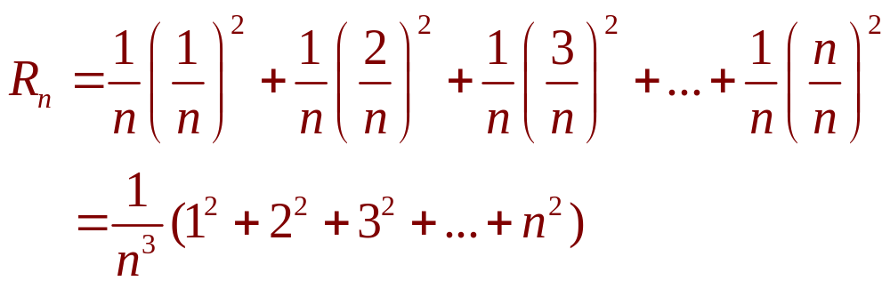
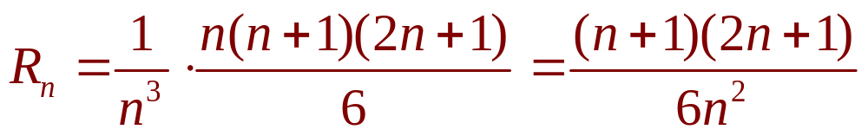
AREA PROBLEM
Example 2
Thus,

Slide 13
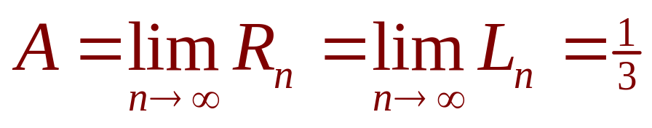
AREA PROBLEM
Thus, we define the area A to be the limit of the sums of the areas of the approximating rectangles, that is,

Slide 14
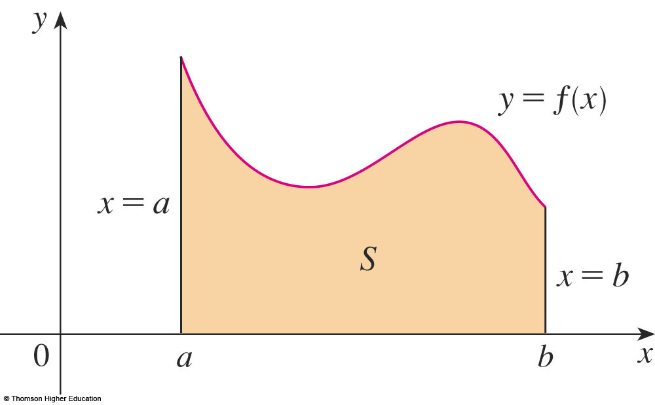
AREA PROBLEM
Let’s apply the idea of Examples 1 and 2
to the more general region S of the earlier figure.

Slide 15
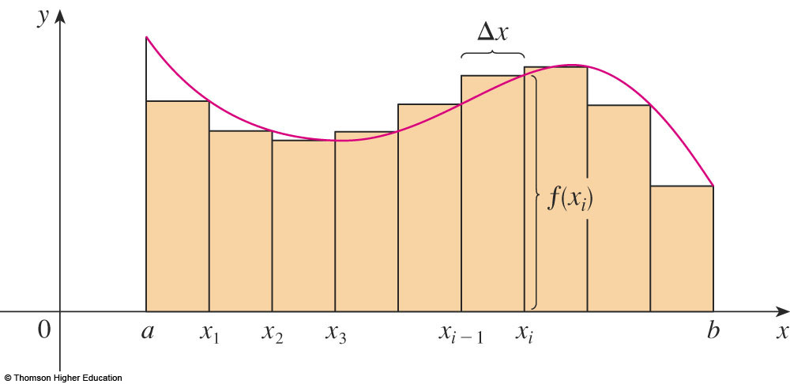
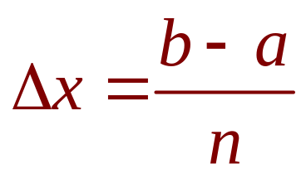
AREA PROBLEM
What we think of intuitively as the area of S is approximated by the sum of the areas of these rectangles:
R_{n} = f(x₁) ∆x + f(x₂) ∆x + … + f(x_{n}) ∆x

Slide 16
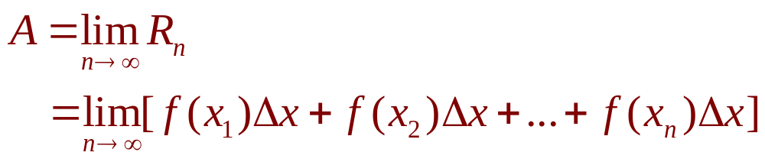
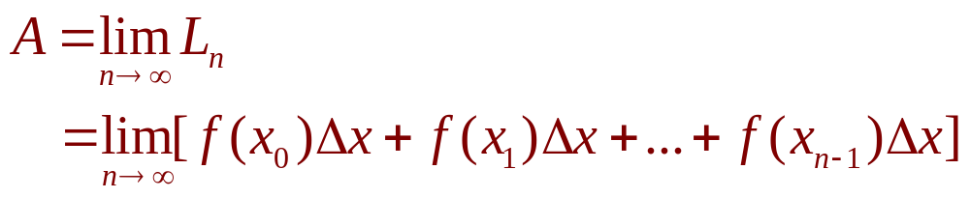
AREA PROBLEM
The area A of the region S that lies under the graph of the continuous function f is the limit of the sum of the areas of approximating rectangles:

Slide 17
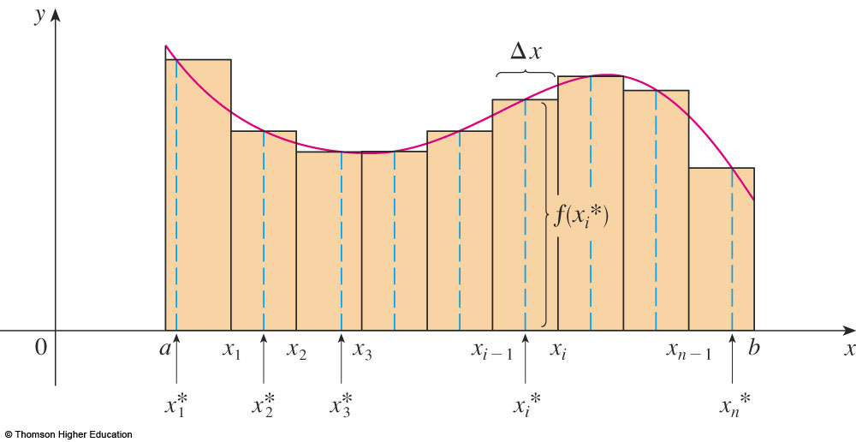
AREA PROBLEM
The figure shows approximating rectangles when the sample points are not chosen to be endpoints.
x_{i}* in the i ^{th} subinterval [x_{i - 1}, x_{i}]
(the sample points)
Notes:
The sample point such as left end point, right end point and midpoint.

Slide 18
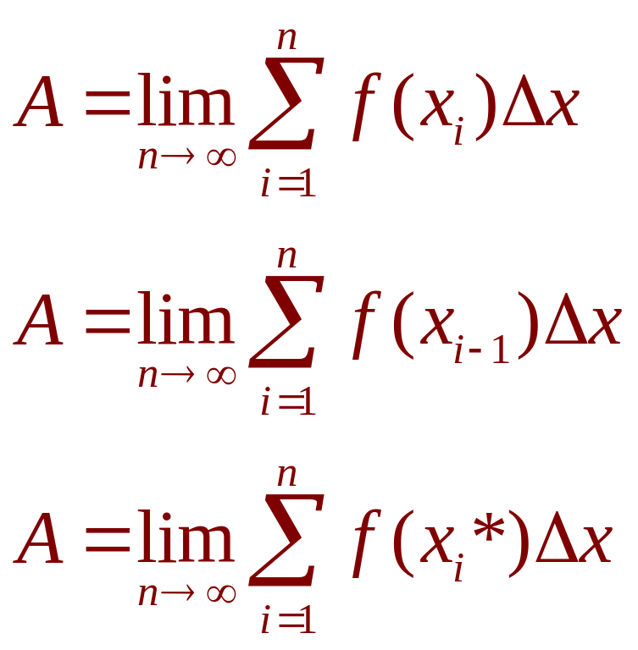
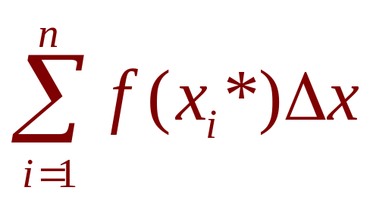
AREA PROBLEM
Hence,
The sum
is called a Riemann sum.

Slide 19
Example
Evaluating the Riemann sum of the following function with four
subintervals. The sample points are the right endpoints.
f(x)= x-1/x (1<=x<=2)
Estimate the area of the region under the graph of y = sin x
on [0,5] with 3 subintervals [0,1]; [1,2.5] and [2.5,5] by using
left-endpoints
3. Find the lower sum for f(x) = 10 – x² on [1,2] with 4 subintervals

Slide 20
INTEGRATION
1.2
The Definite Integral
In this section, we will learn about:
Integrals with limits that represent
a definite quantity.
Notes:
The precise definition of a definite integral.
The definition of an integrable function.
The concept of “area” and “signed area”.

Slide 21
DEFINITE INTEGRAL
If f is a function defined for a ≤ x ≤ b,
we divide the interval [a, b] into n subintervals of equal width ∆x = (b – a)/n.
  We let x₀(= a), x₁, x₂, …, x_{n}(= b) be the endpoints
  of these subintervals.
  We let x₁*, x₂*,…., x_{n}* be any sample points in
  these subintervals, so x_{i}* lies in the i ^{th} subinterval.

Slide 22
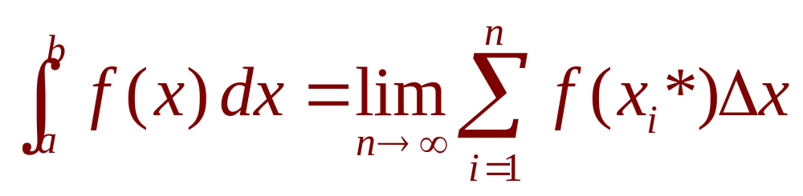
DEFINITE INTEGRAL
Then, the definite integral of f from a to b is
provided that this limit exists.
☞ If it does exist, we say f is integrable on [a, b].
☞ The symbol ∫ was introduced by Leibniz and is called an integral sign.

Slide 23
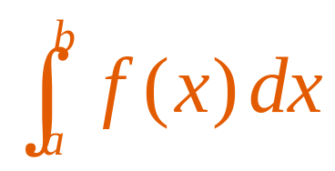
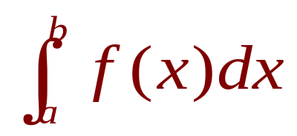
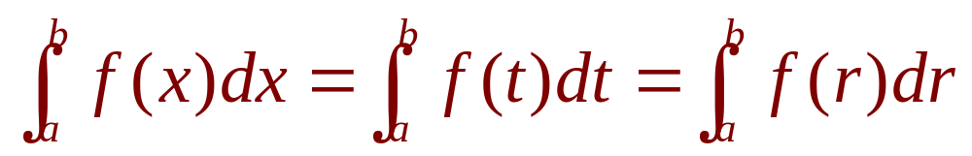
DEFINITE INTEGRAL
The definite integral is a number.
It does not depend on x.
In fact, we could use any letter in place of x without changing the value of the integral:

Slide 24
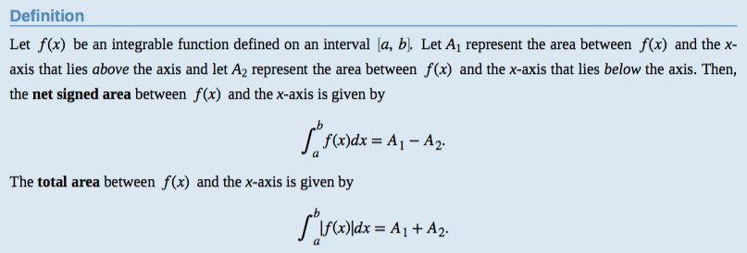
DEFINITE INTEGRAL

Slide 25
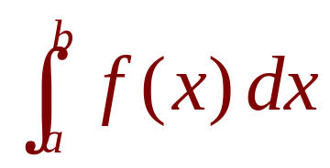
INTEGRABLE FUNCTIONS
If f is continuous on [a, b], or if f has only a finite number of jump discontinuities, then f is integrable on [a, b].
That is, the definite integral exists.

Slide 26
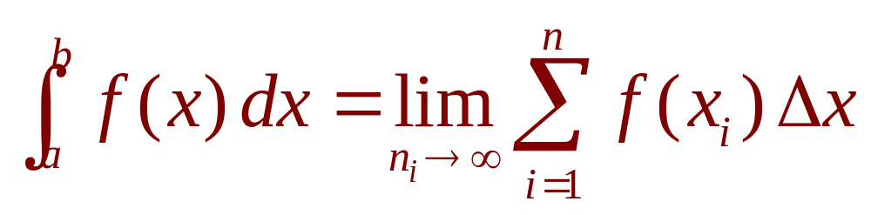
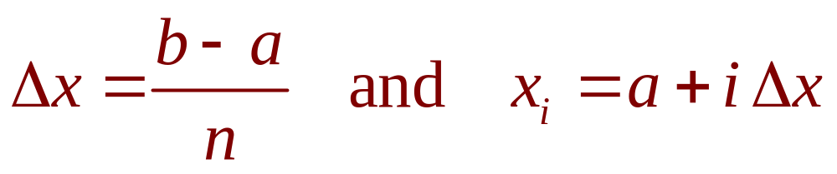
INTEGRABLE FUNCTIONS
If f is integrable on [a, b], then
where

Slide 27
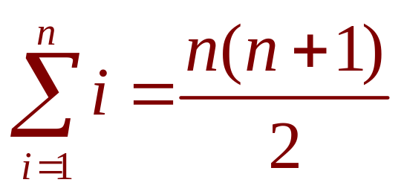
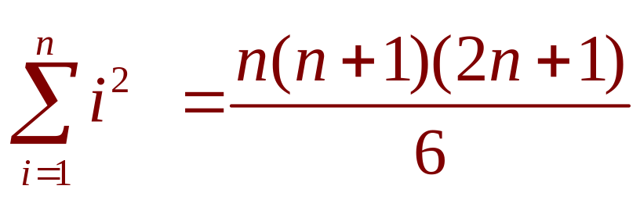
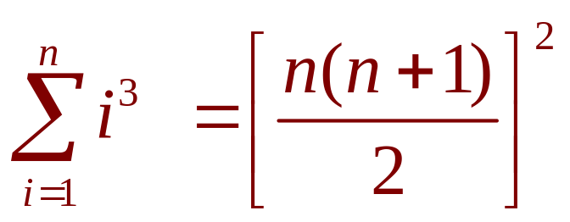
EVALUATING INTEGRALS
The following three equations give formulas for sums of powers of positive integers.

Slide 28
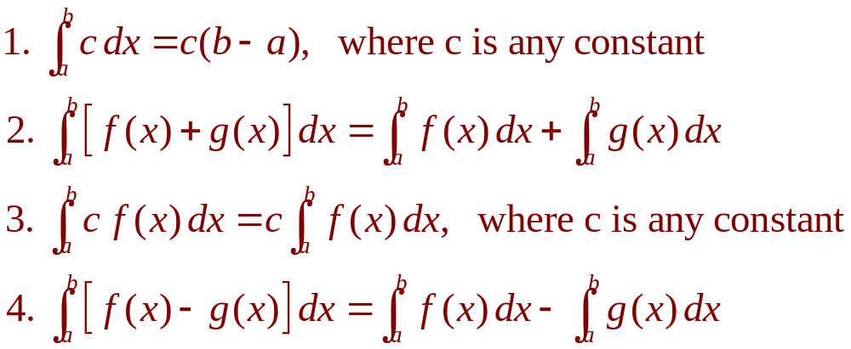
PROPERTIES OF THE INTEGRAL
We assume f and g are continuous functions.

Slide 29
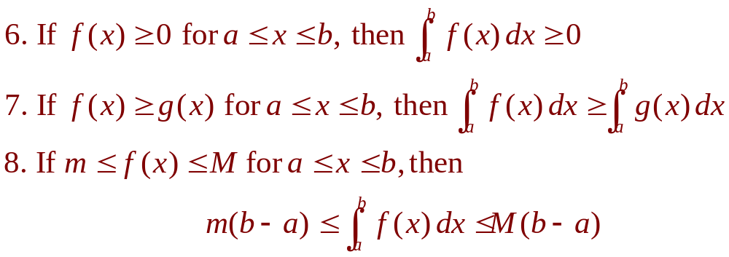
COMPARISON PROPERTIES OF THE INTEGRAL
These properties, in which we compare sizes of functions and sizes of integrals, are true only if a ≤ b.
Notes:
The geometric and comparison properties of definite integrals, developed as statements about area.

Slide 30
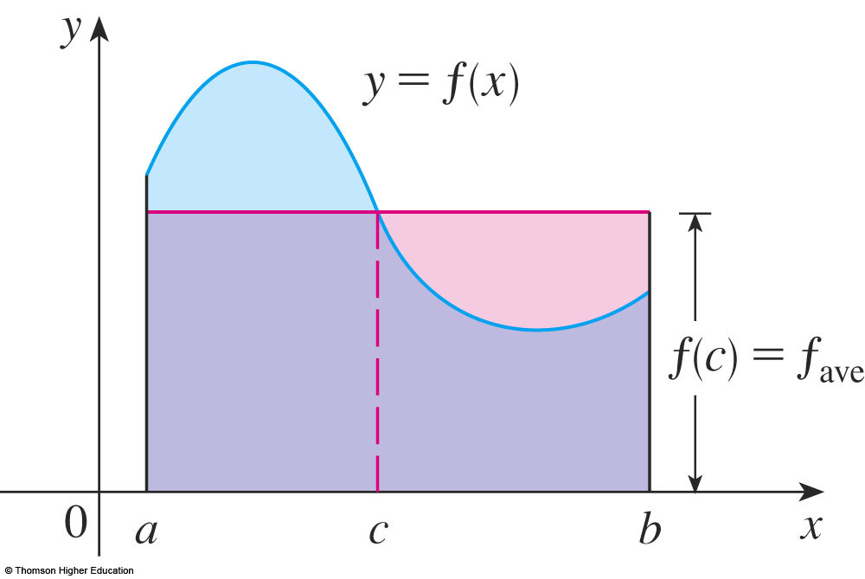
AVERAGE VALUE OF A FUNCTION
The geometric interpretation of the Mean Value Theorem for Integrals is as follows.
  For ‘positive’ functions f, there is a number c such that the rectangle with base [a, b] and height f(c) has the same area as the region under the graph of f from a to b.

Slide 31
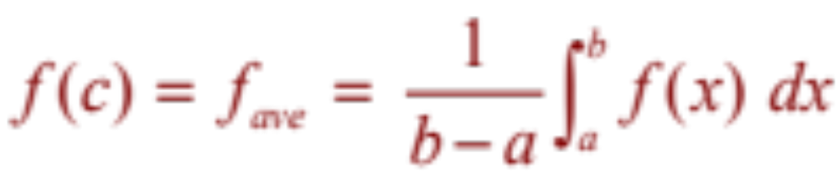
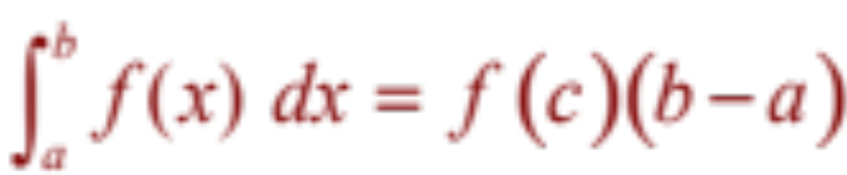
AVERAGE VALUE OF A FUNCTION
If f is continuous on [a, b], then there exists a number c in [a, b] such that
that is,

Slide 32
Example
Find the average value of the function
f(x)=x²+3 on the interval [2,5]

Slide 33
INTEGRATION
1.3
The Fundamental
Theorem of Calculus
In this section, we will learn about:
The Fundamental Theorem of Calculus
and its significance.
Notes:
Precise interpretations of both parts of the Fundamental Theorem of Calculus (FTC1 and FTC2).
When FTC2 can be used.

Slide 34
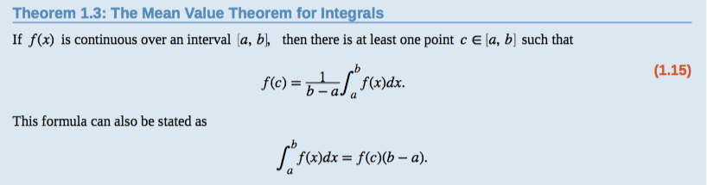
THE MEAN VALUE THEOREM FOR INTEGRALS

Slide 35
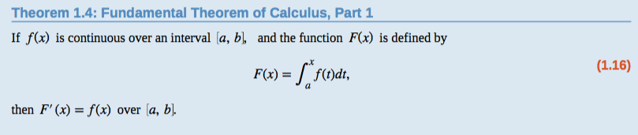
FUNDAMENTAL THEOREM OF CALCULUS PART 1:
Integrals and Antiderivatives

Slide 36
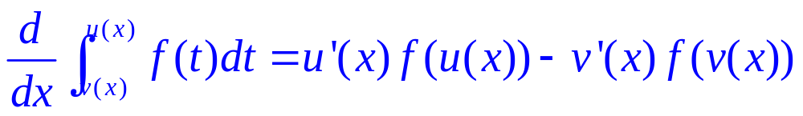
Generalization

Slide 37
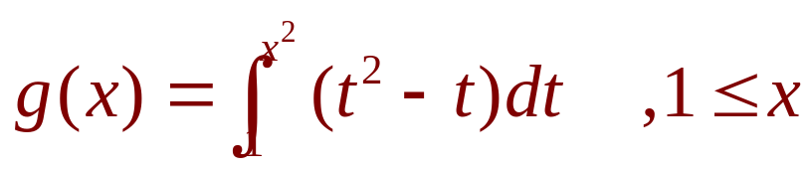
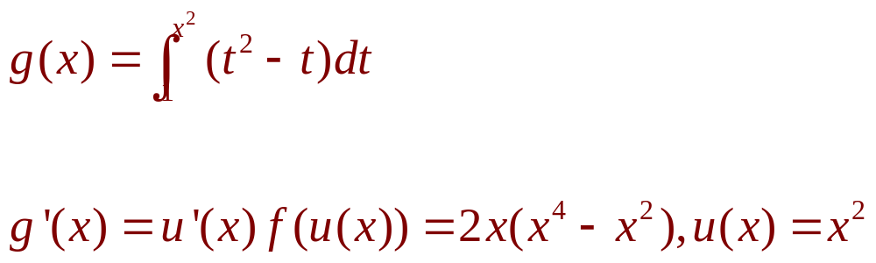
Example
If
Find g’(x)

Slide 38
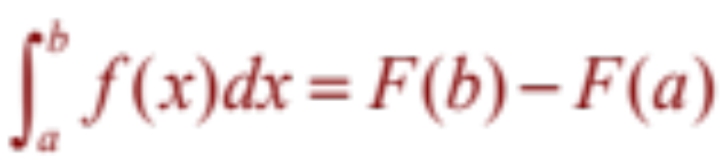
FUNDAMENTAL THEOREM OF CALCULUS PART 2:
If f is continuous on [a, b], then
where F is any antiderivative of f, that is, a function such that F’ = f.
Notes:
The right-hand side is a constant.

Slide 39
INTEGRATION
1.4
Integration Formulas and the Net Change Theorem
In this section, we will learn about:
Integrals with limits that represent
a definite quantity.
Notes:
The precise definition of a definite integral.
The definition of an integrable function.
The concept of “area” and “signed area”.

Slide 40
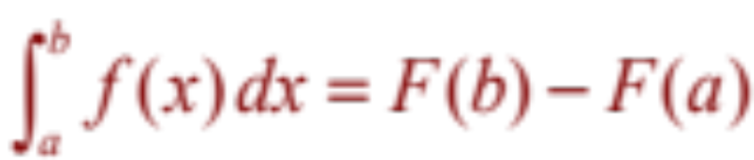
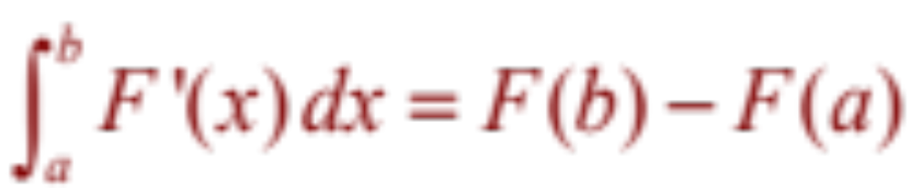
NET CHANGE THEOREM
So, we can reformulate
as follows.
The integral of a rate of change is the net change:

Slide 41
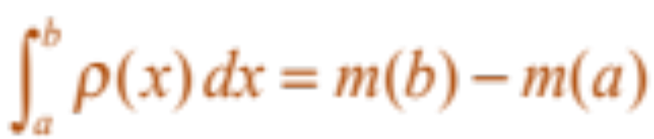
NET CHANGE THEOREM
If the mass of a rod measured from the left end to a point x is m(x), then the linear density is ρ(x) = m’(x).
  So,
  is the mass of the segment of the rod
  that lies between x = a and x = b.
Notes:
The interpretation of the Fundamental Theorem of Calculus 2 as the total change of a rate fuction.

Slide 42
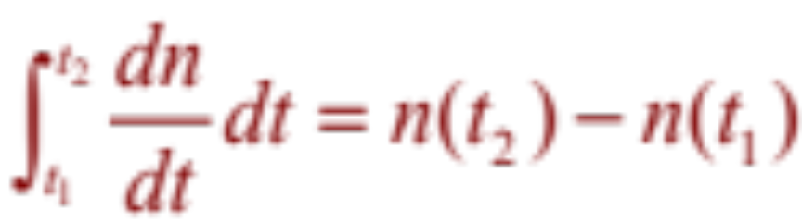
NET CHANGE THEOREM
If the rate of growth of a population is dn/dt, then
is the net change in population during the time period from t₁ to t₂.
  The population increases when births happen
  and decreases when deaths occur.
  The net change takes into account both births
  and deaths.

Slide 43
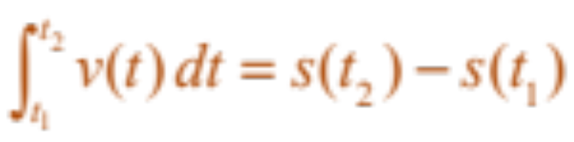
NET CHANGE THEOREM
If an object moves along a straight line
with position function s(t), then its velocity
is v(t) = s’(t).
  So,
  is the net change of position, or displacement,
  of the particle during the time period from t₁ to t₂.

Slide 44
NET CHANGE THEOREM
If we want to calculate the distance the object travels during that time interval, we have to consider the intervals when:
  v(t) ≥ 0 (the particle moves to the right)
  v(t) ≤ 0 (the particle moves to the left)

Slide 45
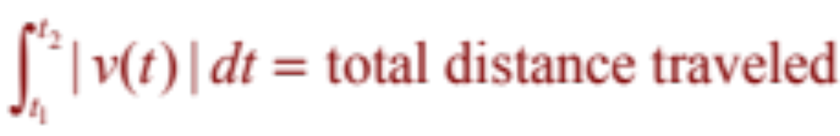
NET CHANGE THEOREM
In both cases, the distance is computed by integrating |v(t)|, the speed.
Therefore,

Slide 46

NET CHANGE THEOREM
The figure shows how both displacement and distance traveled can be interpreted in terms of areas under a velocity curve.
Notes:
displacement ≠ distance

Slide 47

NET CHANGE THEOREM
The acceleration of the object is
a(t) = v’(t).
  So,
  is the change in velocity from time t₁ to time t₂.

Slide 48
NET CHANGE THEOREM
Example
A particle moves along a line so that its velocity at time t is:
v(t) = t² – t – 6 (in meters per second)
  Find the displacement of the particle during
  the time period 1 ≤ t ≤ 4.
  Find the distance traveled during this time period.

Slide 49

NET CHANGE THEOREM
Example a
By Equation 2, the displacement is:
  This means that the particle moved 4.5 m
  toward the left.

Slide 50
NET CHANGE THEOREM
Example b
Note that
v(t) = t² – t – 6 = (t – 3)(t + 2)
  Thus,
  v(t) ≤ 0 on the interval [1, 3] and v(t) ≥ 0 on [3, 4]

Slide 51

NET CHANGE THEOREM
Example b
So, from Equation 3, the distance traveled is:

Slide 52
Example
1. Suppose that the animal population is
increasing at a rate f(t)=3t-1 ( t measured in years).
How much does the animals increase
between the third and the seven years?
2. Suppose the acceleration function and initial velocity are
a(t)=t+3 (m/s²), v(0)=5 (m/s).Find the velocity at
time t and the distance traveled when 0<=t<=5
Notes:
Use FTC2

Slide 53


INTEGRATING OF SYMMETRIC FUNCTIONS
Suppose f is continuous on [–a , a].
If f is even, [f(–x) = f(x)], then
If f is odd, [f(-x) = -f(x)], then

Slide 54

INTEGRATING OF SYMMETRIC FUNCTIONS
This Theorem is
illustrated here.

Slide 55
INTEGRATION
1.5
Substitution
In this section, we will learn:
To substitute a new variable in place of an existing
expression in a function, making integration easier.
Notes:
When we use the substitution rule and how it is used.
During the lecture for this section, show Table 1 on the board

Slide 56
INDEFINITE INTEGRAL
Due to the relation given by the FTC between antiderivatives and integrals, the notation ∫ f(x) dx is traditionally used for an antiderivative of f and is called an indefinite integral.
Thus, ∫ f(x) dx = F(x) means F’(x) = f(x)
Notes:
How they differ from definite integrals. The representation of an indefinite integral as a family of function.
How to quantitatively recover f from f’.

Slide 57

INDEFINITE AND DEFINITE INTEGRALS
You should distinguish carefully between definite and indefinite integrals.
  A definite integral is a number.
  An indefinite integral ∫f(x)dx is a function
  (or family of functions).

Slide 58

TABLE OF INDEFINITE INTEGRALS
Notes:
Requiring that this table be memorized.

Slide 59
SUBSTITUTION RULE
If u = g(x) is a differentiable function whose range is an interval I and f is continuous on I, then
∫ f(g(x))g’(x) dx = ∫ f(u) du

Slide 60

INTRODUCTION
Equation 1
However, our antidifferentiation formulas don’t tell us how to evaluate integrals such as

Slide 61
SUBSTITUTION RULE
Example
Find ∫ x³ cos(x⁴ + 2) dx
  We make the substitution u = x⁴ + 2.
  This is because its differential is du = 4x³ dx,
  which, apart from the constant factor 4,
  occurs in the integral.

Slide 62

SUBSTITUTION RULE
Example
Thus, using x³ dx = du/4 and the Substitution Rule, we have:
  Notice that, at the final stage, we had to return to
  the original variable x.

Slide 63

SUB. RULE FOR DEF. INTEGRALS
Example
Evaluate
  Let u = 3 – 5x.
  Then, du = –5 dx, so dx = –du/5.
  When x = 1, u = –2, and when x = 2, u = –7.

Slide 64


SUB. RULE FOR DEF. INTEGRALS
Equation 5
If g’ is continuous on [a, b] and f is continuous on the range of u = g(x), then
Let F be an antiderivative of f.
Then, F(g(x)) is an antiderivative of f(g(x))g’(x).
So,

Slide 65
Thanks

